Slide 1
Physics, the Fundamental Science

Slide 2

Spirit of Inquiry
Why does the rainbow appear in the east?
What causes the different colors?
Why are the colors in the fainter rainbow in reverse order?
Notes:
Fig.1.01

Slide 3

Spirit of Inquiry
Notes:
Fig.1.01

Slide 4
Scientific Enterprise
How do scientists go about explaining things?
Parallels to Creative Problem Solving?
How do scientific explanations differ from other types of explanations?
Read previous ideas
Test these ideas against observations
Invent an explanation or hypothesis
Devise experiments to test hypothesis
Report results of experiments
Withstand the test of criticism and modifications

Slide 5
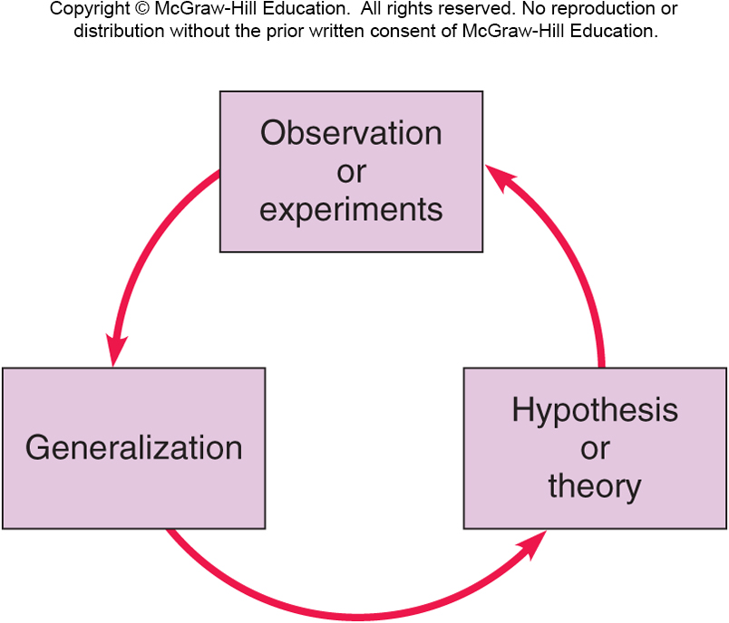
An acceptable explanation must agree with what is observed.
Notes:
Fig.1.03

Slide 6
An acceptable explanation must have predictions that can be tested.
Notes:
Fig.1.03

Slide 7
An acceptable explanation must stand up to criticism.
Notes:
Fig.1.03

Slide 8
Which of the following represent the best explanation we currently have?
Einstein’s Theory of Relativity
Newton’s Law of Gravitation
Einstein’s theory built on Newton’s and better describes observations since Newton’s time.
The concept of theory, as used in science, is often misunderstood.
A theory consists of a set of basic principles.
These principles are often widely accepted.

Slide 9
Scope of Physics
The study of the basic nature of matter
The most fundamental science
Explains fundamental interactions of chemistry, biology, etc. at the atomic or molecular level
Life Sciences
Biology
Health-related
disciplines
Physical Sciences
Physics
Chemistry
Geology
Astronomy, etc.

Slide 10
Scope of Physics
The study of the basic nature of matter
The most fundamental science
Explains fundamental interactions of chemistry, biology, etc. at the atomic or molecular level
The most quantitative science
Heavy use of mathematics
Numerical measurements
Can be described more simply and cleanly than other sciences
NOT just a collection of facts to memorize!

Slide 11
Subfields of Physics
Classical Physics
Mechanics - forces and motion
Thermodynamics - temperature, heat, energy
Electricity and Magnetism
Optics - light

Slide 12
Subfields of Physics
Classical Physics
Mechanics - forces and motion
Thermodynamics - temperature, heat, energy
Electricity and Magnetism
Optics - light
Modern Physics
Atomic physics - atoms
Nuclear physics - nucleus of the atom
Particle physics - subatomic particles: quarks, etc
Condensed matter physics - solids and liquids

Slide 13

Notes:
Fig.1.09

Slide 14
Subfields of Physics
Interdisciplinary Fields
Biophysics
Geophysics
Astrophysics
Physicists: fundamental understanding
Engineers: practical applications
Often overlapping roles

Slide 15
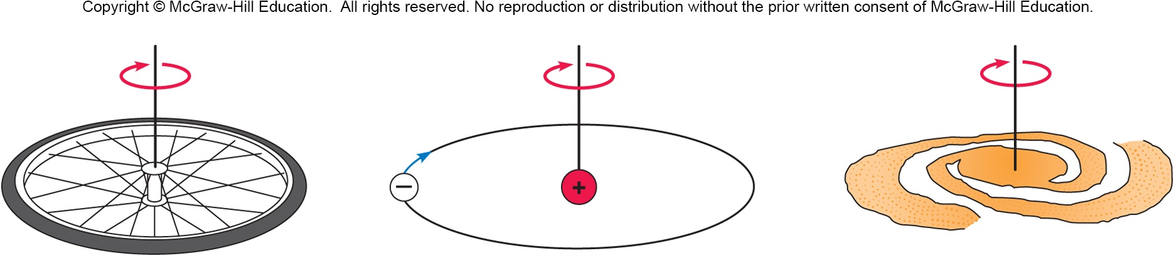
Why study everyday phenomena?
The same physical principles that govern our everyday experiences also govern the entire universe
A bicycle wheel, an atom, and a galaxy all operate according to laws for angular momentum.

